Slide 1
Machine Translation
Using Sequence-to-Sequence Modeling

Slide 2
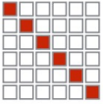
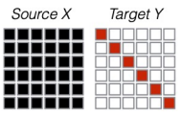
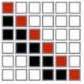
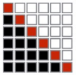
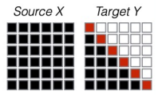

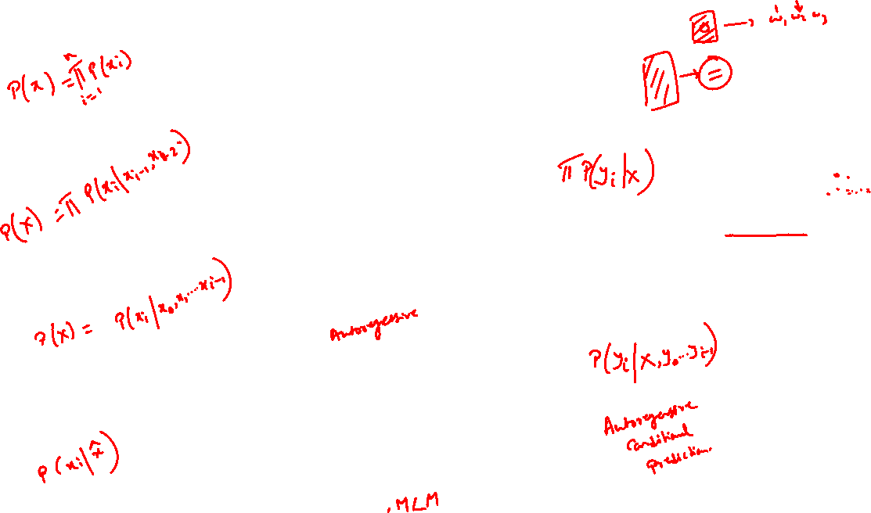
Recap
Unigram LMs
Sequence labeling, summarization
N-gram LMs, fixed window
RNN
Sequence-sequence, translation etc.
Bi-LSTM

Slide 3
Sequence-to-Sequence Modeling
Introduce a new task: Machine Translation
Re-Introduce a neural architecture: sequence-to-sequence
Re-Introduce: attention

Slide 4
Sequence-to-Sequence is versatile!
Sequence-to-sequence is useful for more than just MT
Many NLP tasks can be phrased as sequence-to-sequence:
Summarization (long text → short text)
Dialogue (previous utterances → next utterance)
Parsing (input text → output parse as sequence)
Code generation (natural language → Python code)
Also used in Computer Vision
Image description generation

Slide 5
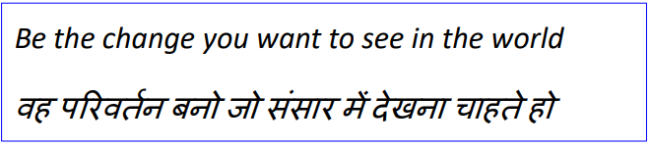
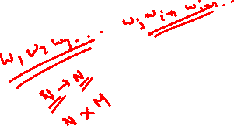
Machine Translation
Machine Translation (MT) is the task of translating a sentence x from one language (the source language) to a sentence y in another language (the target language).

Slide 6
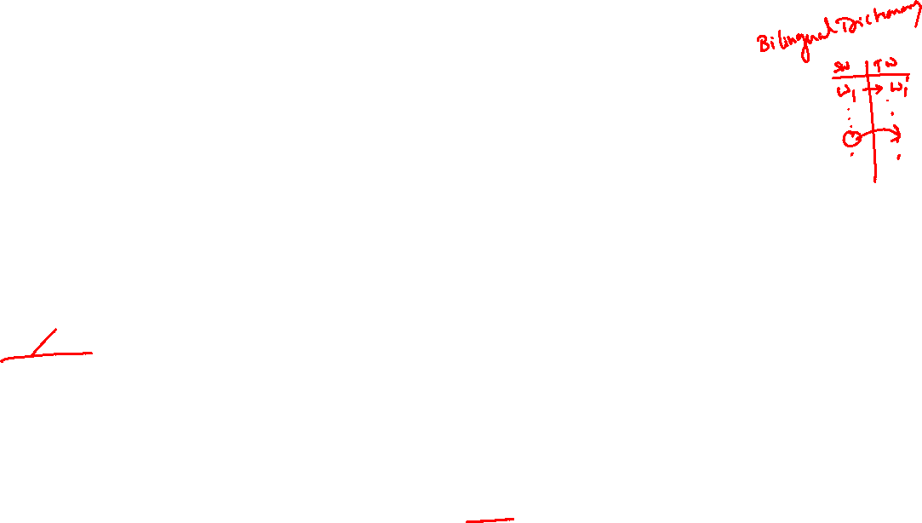
1950s: Early Machine Translation
Machine Translation research began in the early 1950s.
Russian → English (motivated by the Cold War!)
Systems were mostly rule-based, using a bilingual dictionary to map Russian words to their English counterparts
https://www.youtube.com/watch?v=K-HfpsHPmvw

Slide 7
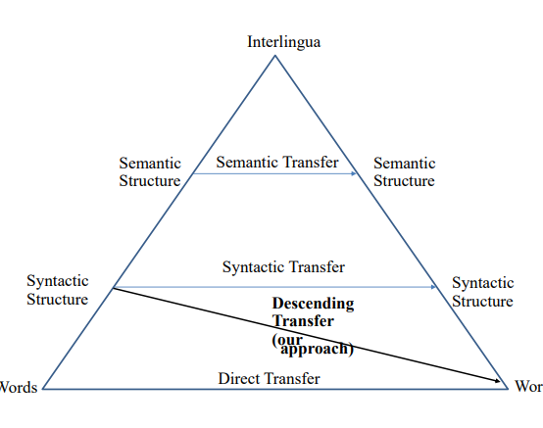
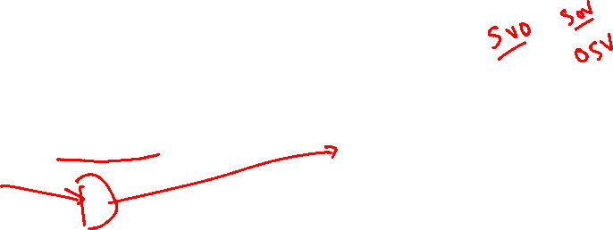
MT Approaches
Rule Based
Statistical
Neural

Slide 8
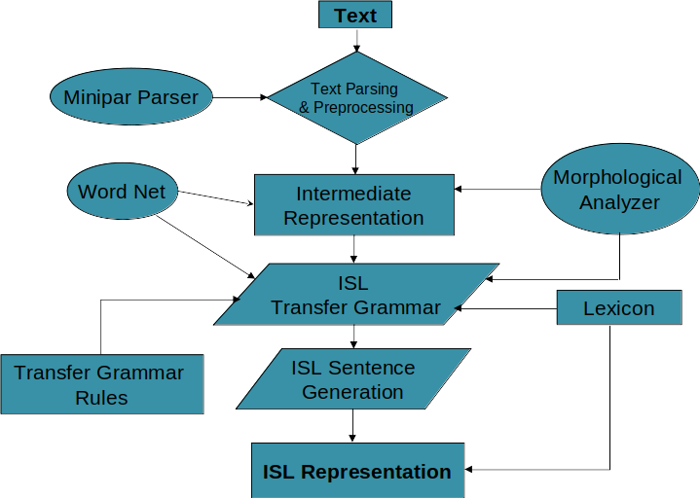
Typical Rule-based MT Systems

Slide 9
Intermediate Representation
The dependency structure is represented by recursive frame based structure.
Each frame corresponds to the higher syntactic and functional information of a sentence
This higher syntactic and functional information is represented as a set of attribute-value pairs.

Slide 10
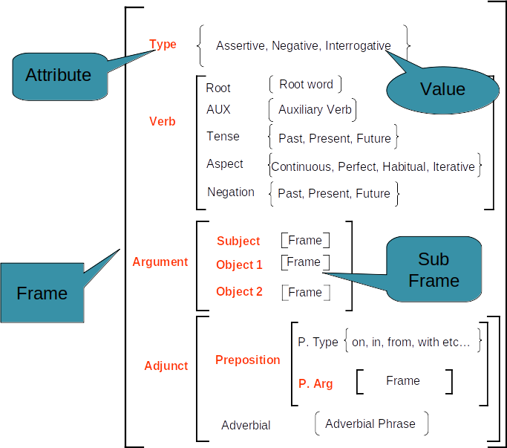
Recursive Frame

Slide 11
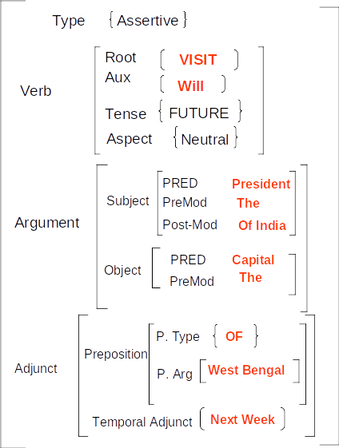
Example:
“The President of India will visit
the capital of west Bengal
next week”

Slide 12
The Transfer Phase
Mapping of source language frame (s-frame) to target language frame (t-frame)
Lexical selection
Structural Association
Many languages are free word order
SOV pattern is preferred
We define generic mapping rule for English to <TL> syntactic transfer
Rules were constructed with the help of <TL> experts
Rules may vary based on sentence type

Slide 13
Example Rules
Rule 1: [SPre-Mod][S][SM][V][VM][O][OM][AT] → [A’T][S’M][S’][SPre-Mod][O’M][O’][V’M][V’]
Rule 2: [Aux][S][SM][V][VM][O][OM][AT] → [A’T][S’M][S’][O’M][O’][V’M][V’][Yes/no-Marker]
Rule 3: [Wh-Phrase][S][SM][V][VM][O][OM][AT] → [A’T][S’M][S’][O’M][O’][V’M][V’][Wh-Phrase]
Rule 4: Pred (X, Premod, Prep) Pred (X)
Rule 5: Pred (X, Premod, Indef Det) → Pred (X, Premod, INDEX (?))
Rule 6: Pred (X, AUX) → 0
Rule 7: Tense (X, Future), Verb(X) → Verb (X+<Future>)
Rule 8: Tense (X, Past), Verb (X) → Verb (X+<Past>)
Rule 9: Tense (X, Present), Prog (X) → 0
Rule 10: Pred (X, Pronoun, person=1,number=1) → Pred (INDEXIPSI)
Rule 11: Pred (X, Premod, Adj) → Pred (X, Postmod, Adj)

Slide 14
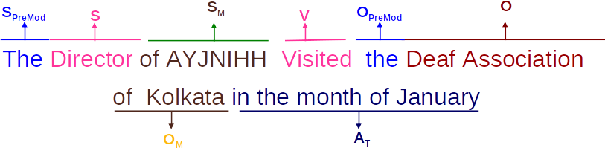
Example
The Director of AYJNIHH Visited the Deaf Association of Kolkata in the month of January
S_{Premod}: Subject Pre-modifier
S : Subject of a sentence
S_{M} : Subject modifier of a sentence
O : Object of a sentence
O_{M}: Object modifier of a sentence
V : The Verb Group of a sentence
AT: Temporal Adjuncts

Slide 15
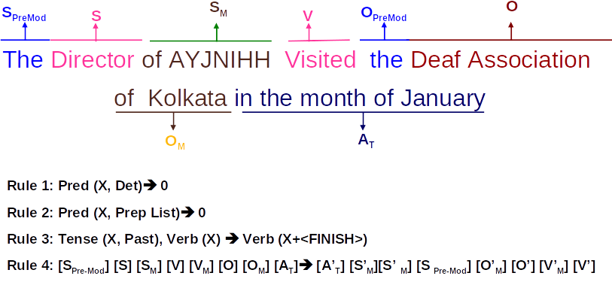

Slide 16


1990s-2010s: Statistical Machine Translation
Core idea: Learn a probabilistic model from data
Suppose we’re translating Hindi → English.
We want to find best English sentence y, given Hindi sentence x
Use Bayes Rule to break this down into two components to be learnt separately

Slide 17
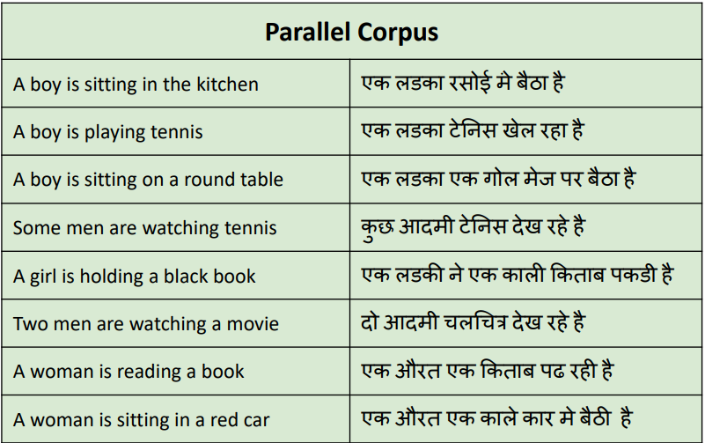
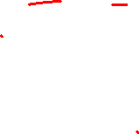
Question: How to learn translation model ?
First, need large amount of parallel data (e.g. pairs of human-translated Hindi/English sentences)

Slide 18
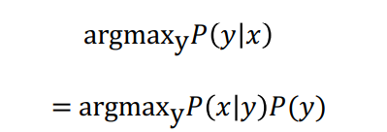
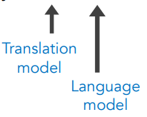
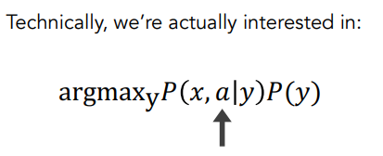
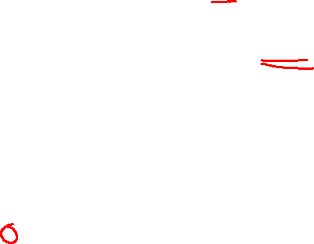
Learning alignment for SMT
Question: How to learn translation model from the parallel corpus?
Break it down further: Introduce a latent variable into the model:
where a is the alignment, i.e. word-level correspondence between source sentence x and target sentence y

Slide 19
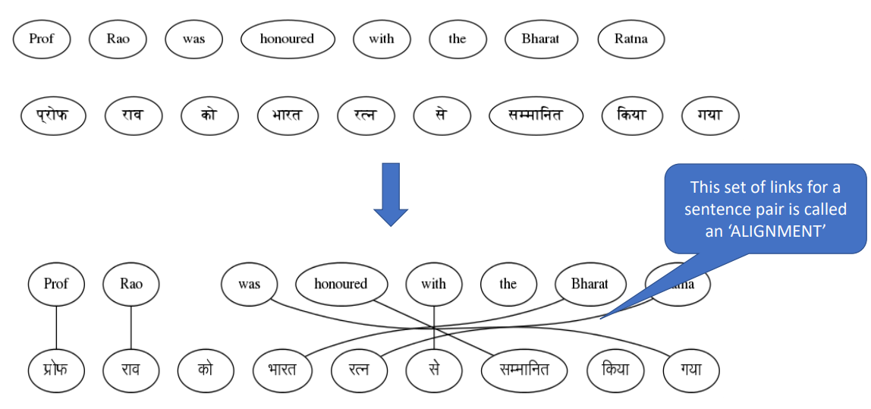
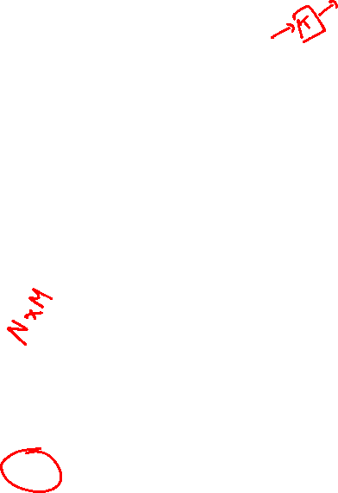

Slide 20
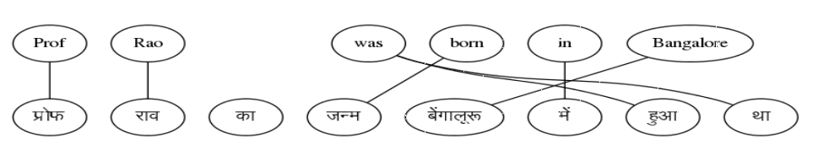
What is alignment?
Alignment is the correspondence between particular words in the translated sentence pair.
Typological differences between languages lead to complicated alignments!
Note: Some words have no counterpart
Alignment can be many-to-one
Alignment can be one-to-many
Alignment can be many-to-many (phrase-level)

Slide 21
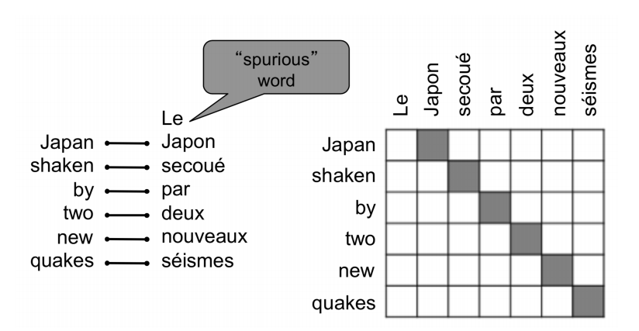
What is alignment?
Alignment is the correspondence between particular words in the translated sentence pair.
Typological differences between languages lead to complicated alignments!
Note: Some words have no counterpart

Slide 22
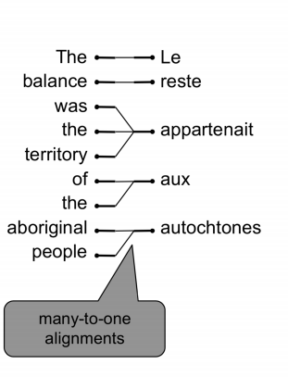
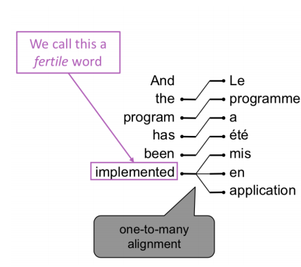
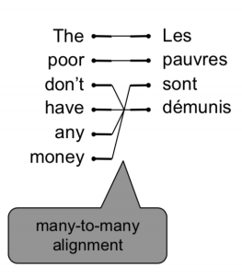
Alignment is complex
Alignment can be many-to-one
Alignment can be one-to-many
Alignment can be many-to-many (phrase-level)

Slide 23

Learning alignment for SMT
We learn P(x,a|y) as a combination of many factors, including:
Probability of particular words aligning (also depends on position in sent)
Probability of particular words having particular fertility (number of corresponding words)
Alignments ‘a’ are latent variables: They aren’t explicitly specified in the data!

Slide 24
What is Neural Machine Translation?
Neural Machine Translation (NMT) is a way to do Machine Translation with a single neural network
The neural network architecture is called sequence-to-sequence (aka seq2seq) and it involves two RNNs.

Slide 25
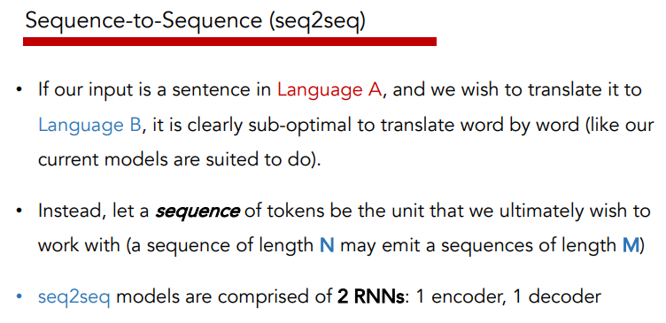

Slide 26
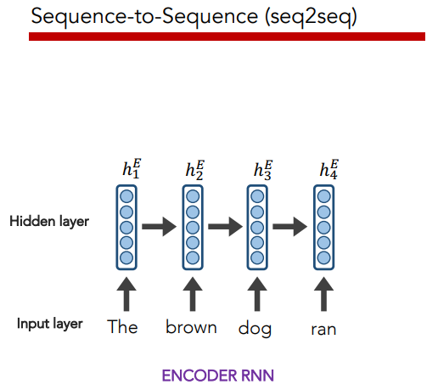

Slide 27
The final hidden state of the encoder RNN is the initial state of the decoder RNN

Slide 28

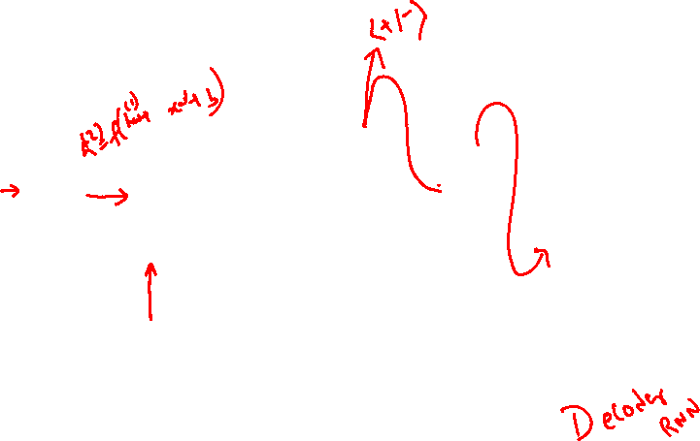
The final hidden state of the encoder RNN is the initial state of the decoder RNN

Slide 29
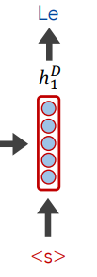
The final hidden state of the encoder RNN is the initial state of the decoder RNN

Slide 30
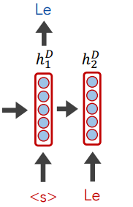
The final hidden state of the encoder RNN is the initial state of the decoder RNN

Slide 31
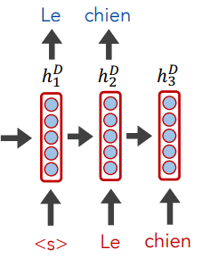
The final hidden state of the encoder RNN is the initial state of the decoder RNN

Slide 32
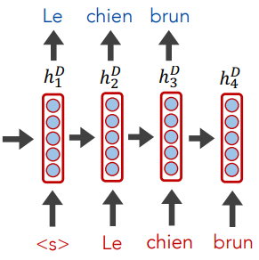
The final hidden state of the encoder RNN is the initial state of the decoder RNN

Slide 33
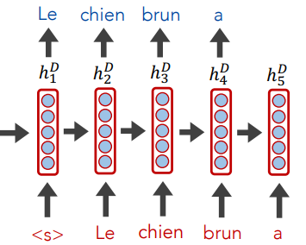
The final hidden state of the encoder RNN is the initial state of the decoder RNN

Slide 34
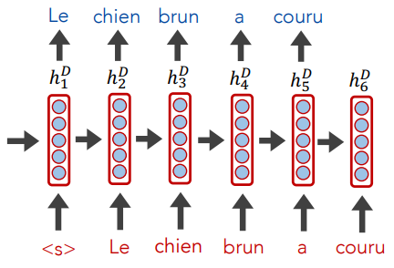
The final hidden state of the encoder RNN is the initial state of the decoder RNN

Slide 35
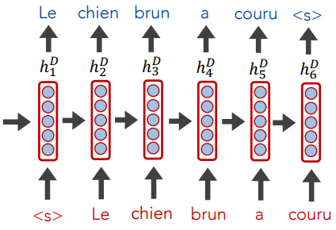
The final hidden state of the encoder RNN is the initial state of the decoder RNN

Slide 36
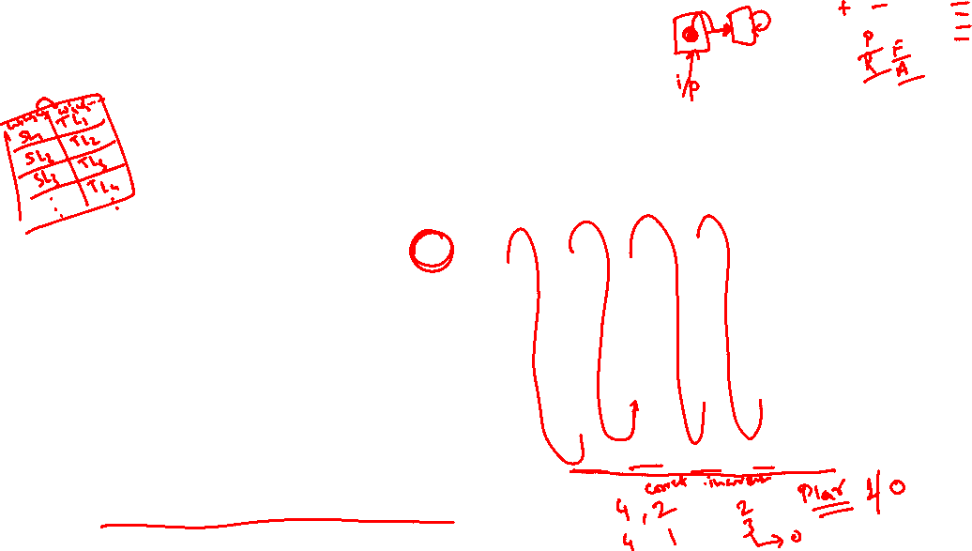
The final hidden state of the encoder RNN is the initial state of the decoder RNN
Training occurs like RNNs typically do; the loss (from the decoder outputs) is calculated, and we update weights all the way to the beginning (encoder)

Slide 37
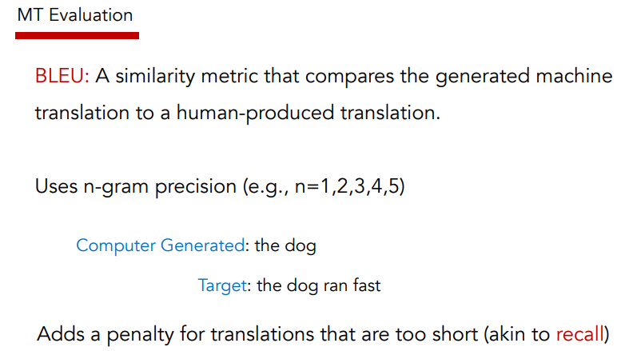
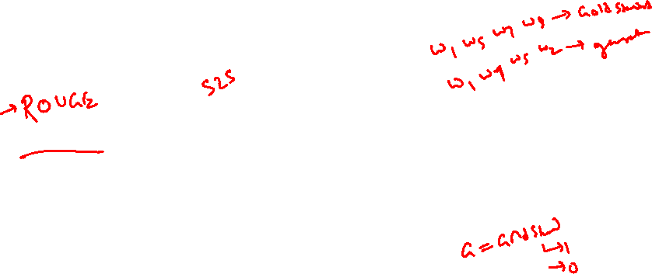

Slide 38
It’s crazy that the entire “meaning” of the 1st sequence is expected to be packed into this one embedding, and that the encoder then never interacts w/ the decoder again. Hands free.
The final hidden state of the encoder RNN is the initial state of the decoder RNN
Instead, what if the decoder, at each step, pays attention to a distribution of all of the encoder’s hidden states?

Slide 39
Attention
Intuition: when we (humans) translate a sentence, we don’t just consume the original sentence, reflect on the meaning of the last word, then regurgitate in a new language; we continuously think back at the original sentence while focusing on different parts.

Slide 40





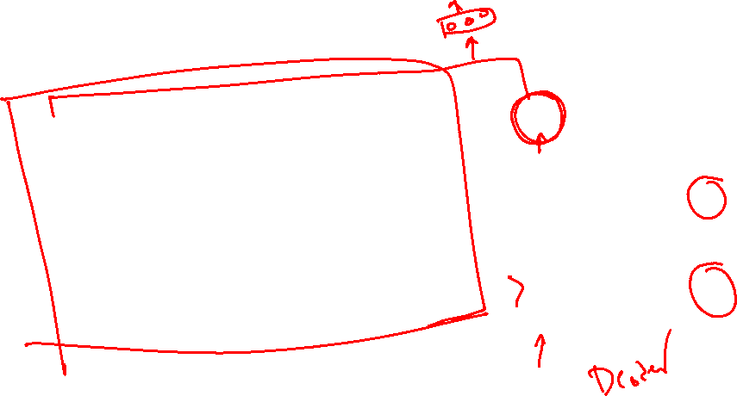



seq2seq + Attention
Q→ How do we determine how much to pay attention to each of the encoder’s hidden layers?
Ans→ Let’s base it on our decoder’s current hidden state (our current representation of meaning) and all of the encoder’s hidden layers!
$$H_{1}$$
$$H_{2}$$
$$H_{3}$$
$$H_{4}$$
$$H_{1}^{o}$$
Hidden
layer
$$H_{1}$$
1.5
$$e_{1}$$
$$H_{1}^{O}$$
input
The brown dog ran
<s>

Slide 41


seq2seq + Attention
Q→ How do we determine how much to pay attention to each of the encoder’s hidden layers?
Ans→ Let’s base it on our decoder’s current hidden state (our current representation of meaning) and all of the encoder’s hidden layers!
$$H_{1}$$
$$H_{2}$$
$$H_{3}$$
$$H_{4}$$
$$H_{1}^{o}$$
Hidden
layer
$$H_{2}$$
0.9
$$e_{2}$$
$$H_{1}^{O}$$
input
The brown dog ran
<s>

Slide 42


seq2seq + Attention
Q→ How do we determine how much to pay attention to each of the encoder’s hidden layers?
Ans→ Let’s base it on our decoder’s current hidden state (our current representation of meaning) and all of the encoder’s hidden layers!
$$H_{1}$$
$$H_{2}$$
$$H_{3}$$
$$H_{4}$$
$$H_{1}^{o}$$
Hidden
layer
$$H_{3}$$
0.2
$$e_{3}$$
$$H_{1}^{O}$$
input
The brown dog ran
<s>

Slide 43


seq2seq + Attention
Q→ How do we determine how much to pay attention to each of the encoder’s hidden layers?
Ans→ Let’s base it on our decoder’s current hidden state (our current representation of meaning) and all of the encoder’s hidden layers!
$$H_{1}$$
$$H_{2}$$
$$H_{3}$$
$$H_{4}$$
$$H_{1}^{o}$$
Hidden
layer
$$H_{4}$$
-0.5
$$e_{4}$$
$$H_{1}^{O}$$
input
The brown dog ran
<s>

Slide 44

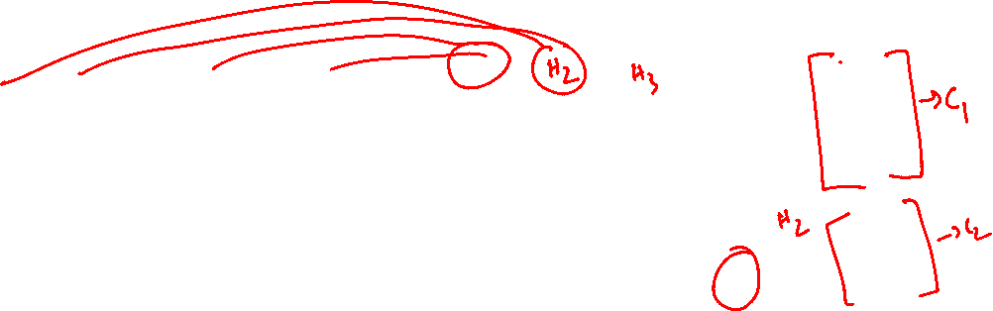
seq2seq + Attention
Q→ How do we determine how much to pay attention to each of the encoder’s hidden layers?
Ans→ Let’s base it on our decoder’s current hidden state (our current representation of meaning) and all of the encoder’s hidden layers!
Attention (raw scores)
$$H_{1}$$
$$H_{2}$$
$$H_{3}$$
$$H_{4}$$
$$H_{1}^{o}$$
e1: 1.5
e2: 0.9
e3: 0.2
e4: -0.5
Hidden
layer
Attention (softmax’d)
input
The brown dog ran
<s>

Slide 45
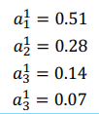

seq2seq + Attention
Q→ How do we determine how much to pay attention to each of the encoder’s hidden layers?
Ans→ Let’s base it on our decoder’s current hidden state (our current representation of meaning) and all of the encoder’s hidden layers!
Attention (raw scores)
$$H_{3}$$
$$H_{1}^{o}$$
e1: 1.5
e2: 0.9
e3: 0.2
e4: -0.5
$$H_{1}$$
$$H_{2}$$
$$H_{4}$$
Hidden
layer
Attention (softmax’d)
input
The brown dog ran
<s>

Slide 46

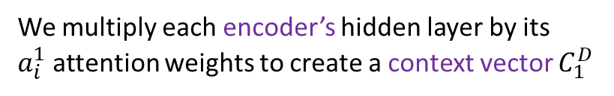

seq2seq + Attention
Q→ How do we determine how much to pay attention to each of the encoder’s hidden layers?
We multiply each encoder’s hidden layer by its $a_{i}^{1}$attention weights to create a context vector $C_{1}^{D}$
$$C_{1}^{D}$$
$$H_{1}$$
$$H_{2}$$
$$H_{3}$$
$$H_{4}$$
$$H_{1}^{o}$$
Hidden
layer
Attention (softmax’d)
input
The brown dog ran
<s>

Slide 47

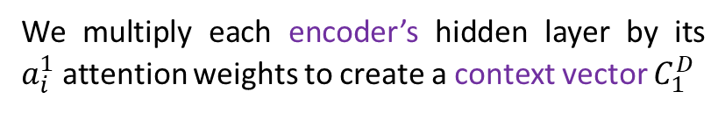

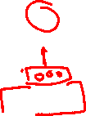




seq2seq + Attention
Q→ How do we determine how much to pay attention to each of the encoder’s hidden layers?
We multiply each encoder’s hidden layer by its $a_{i}^{1}$attention weights to create a context vector $C_{1}^{D}$
$$C_{1}^{D}$$
$$y_{1}$$
$$a_{1}^{4}$$
$$a_{1}^{1}$$
$$a_{1}^{2}$$
$$a_{1}^{3}$$
$$H_{1}$$
$$H_{2}$$
$$H_{3}$$
$$H_{4}$$
${[H}_{1}^{o};$ $C_{1}^{D}]$
Hidden
layer
input
The brown dog ran
<s>

Slide 48

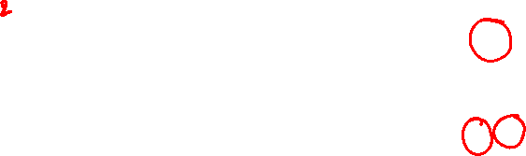





seq2seq + Attention
Q→ How do we determine how much to pay attention to each of the encoder’s hidden layers?
We multiply each encoder’s hidden layer by its $a_{i}^{1}$attention weights to create a context vector $C_{1}^{D}$
$$C_{1}^{D}$$
$$y_{1}$$
$$y_{2}$$
$$a_{2}^{4}$$
$$a_{2}^{1}$$
$$a_{2}^{2}$$
$$a_{2}^{3}$$
$$H_{1}$$
$$H_{2}$$
$$H_{3}$$
$$H_{4}$$
${[H}_{1}^{o};$ $C_{1}^{D}]$
${[H}_{2}^{o};$ $C_{2}^{D}]$
Hidden
layer
input
The brown dog ran
<s>
y1

Slide 49






seq2seq + Attention
Q→ How do we determine how much to pay attention to each of the encoder’s hidden layers?
We multiply each encoder’s hidden layer by its $a_{i}^{1}$attention weights to create a context vector $C_{1}^{D}$
$$C_{1}^{D}$$
$$y_{1}$$
$$y_{2}$$
$$y_{3}$$
$$a_{3}^{4}$$
$$a_{3}^{1}$$
$$a_{3}^{2}$$
$$a_{3}^{3}$$
$$H_{1}$$
$$H_{2}$$
$$H_{3}$$
$$H_{4}$$
${[H}_{1}^{o};$ $C_{1}^{D}]$
${[H}_{2}^{o};$ $C_{2}^{D}]$
${[H}_{3}^{o};$ $C_{3}^{D}]$
Hidden
layer
input
The brown dog ran
<s>
y1
y2

Slide 50






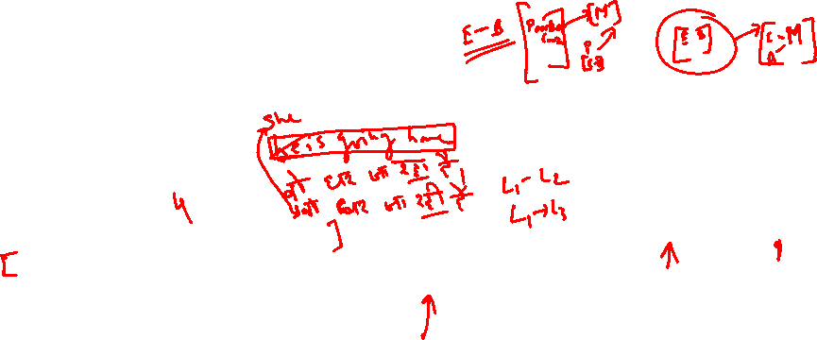
seq2seq + Attention
Q→ How do we determine how much to pay attention to each of the encoder’s hidden layers?
We multiply each encoder’s hidden layer by its $a_{i}^{1}$attention weights to create a context vector $C_{1}^{D}$
$$C_{1}^{D}$$
$$y_{1}$$
$$y_{2}$$
$$y_{3}$$
$$y_{4}$$
$$a_{4}^{4}$$
$$a_{4}^{1}$$
$$a_{4}^{2}$$
$$a_{4}^{3}$$
$$H_{1}$$
$$H_{2}$$
$$H_{3}$$
$$H_{4}$$
${[H}_{1}^{o};$ $C_{1}^{D}]$
${[H}_{3}^{o};$ $C_{3}^{D}]$
${[H}_{4}^{o};$ $C_{4}^{D}]$
The Attention mechanism that produces scores doesn’t have to be a FFNN like I illustrated. It can be any function you wish.
${[H}_{2}^{o};$ $C_{2}^{D}]$
Hidden
layer
input
The brown dog ran
<s>
y1
y2
y3

Slide 52




















LM vs MT
Language Model
Machine Translation
$${\hat{y}}^{(1)}$$
$${\hat{y}}^{(2)}$$
$${\hat{y}}^{(T)}$$
$${\hat{y}}^{(1)}$$
$${\hat{y}}^{(2)}$$
$${\hat{y}}^{(T)}$$
$$h^{(0)}$$
$$h^{(1)}$$
$$h^{(0)}$$
$$h^{(1)}$$
$$x^{(1)}$$
$$x^{(1)}$$
$$x^{(1)}$$
$${\hat{y}}^{(T)}$$
$${\hat{y}}^{(1)}$$
$${\hat{y}}^{(2)}$$
$${\hat{y}}^{(T)}$$
$$h^{(0)}$$
$$h^{(1)}$$
$$h^{(∗)}$$
$$h^{(1)}$$
$$x^{(1)}$$
$$x^{(1)}$$
$$x^{(1)}$$

Slide 53

Neural Seq-Seq Generation Model

Slide 54


Training a Neural Machine Translation system

Slide 55


Exhaustive search decoding
Ideally we want to find a (length T) translation y that maximizes
We could try computing all possible sequences y
This means that on each step t of the decoder, we’re tracking V^{t} possible partial translations, where V is vocab size
This O(V^{T}) complexity is far too expensive!

Slide 56


Greedy decoding
We saw how to generate (or “decode”) the target sentence by taking argmax on each step of the decoder
This is greedy decoding (take most probable word on each step)
Problems with this method?

Slide 57






Beam Search Algorithm
$${\hat{y}}^{(T)}$$
a
arron
$$h^{(0)}$$
jane
September
$$x^{(1)}$$
$$x^{(T)}$$
a
visit
an
zulu
arron
$${\hat{y}}^{(T)}$$
a
in
arron
$$h^{(0)}$$
jane
jane
September
$$x^{(1)}$$
$$x^{(T)}$$
visit
zulu
September
$${\hat{y}}^{(T)}$$
a
$$h^{(0)}$$
arron
jane
September
$$x^{(1)}$$
$$x^{(T)}$$
zulu
visit
Jane visits Africa in September. <EOS>
zulu

Slide 58


The problem of Long Sequences
His long, sleek hair was tied in a tight braid, and despite the cold and wind he wore only a long-sleeved sweater that hugged the muscles of his arms and shoulders beneath a down vest.
उसके लंबे, चिकने बाल एक तंग चोटी में बंधे हुए थे, और ठंड और हवा के बावजूद उसने केवल एक लंबी बाजू का स्वेटर पहना था जो नीचे की बनियान के नीचे उसकी बाहों और कंधों की मांसपेशियों को गले लगाता था।

Slide 59


Attention Model
Let us motivate the task of attention with the help of MT
The encoder reads the sentences only once and encodes it
At each timestep the decoder uses this embedding to produce a new word
Is this how humans translate a sentence ?
Humans try to produce each word in the output by focusing only on certain words in the input

Slide 60

Attention Model
Humans try to produce each word in the output by focusing only on certain words in the input
Essentially at each time step we come up with a distribution on the input words

Slide 61

Attention Model
Humans try to produce each word in the output by focusing only on certain words in the input
Essentially at each time step we come up with a distribution on the input words

Slide 62


Attention Model
Humans try to produce each word in the output by focusing only on certain words in the input
Essentially at each time step we come up with a distribution on the input words
This distribution tells us how much attention to pay to each input words at each time step
Ideally, at each time-step we should feed only this relevant information (i.e. encodings of relevant words) to the decoder

Slide 63


Attention Model
Let us revisit the decoder that we have seen so far
We either feed in the encoder information only once(at s₀)
Or we feed the same encoder information at each time step

Slide 64


Attention Model
We could just take a weighted average of the corresponding word representations and feed it to the decoder

Slide 65

Attention Model
We could just take a weighted average of the corresponding word representations and feed it to the decoder
For example at timestep 3, we can just take a weighted average of the representations of ‘ja’ and ‘raha’

Slide 66

Attention Model
We could just take a weighted average of the corresponding word representations and feed it to the decoder
For example at timestep 3, we can just take a weighted average of the representations of ‘ja’ and ‘raha’
Intuitively this should work better because we are not overloading the decoder with irrelevant information (about words that do not matter at this time step)

Slide 67












Attention Model
$$α^{(t,t^{′})}=amount of attention y^{(t)} should pay to h^{(t^{′})}$$
$$α^{(t,t^{′})}= \frac{exp⁡(e^{(t,t^{′})}}{\sum_{t′}^{T_{x}}{exp⁡(e^{(t,t^{′})}}}$$
$${\hat{y}}^{(t−1)}$$
$${\hat{y}}^{(t)}$$
$$S^{(t−1)}$$
$$S^{(t)}$$
$$s^{(t−1)}$$
$$e^{(t,t^{′})}$$
+
$$h^{(t′)}$$
$$h^{(0)}$$
$$x^{(1)}$$
$$x^{(2)}$$
$$x^{(3)}$$
$$x^{(t−1)}$$
$$x^{(t)}$$

Slide 68


Attention Visualization
Machine Translation
Sentiment Classification

